Slide 1

CRITERIA B

Slide 2
HOW IT LOOKS
Criteria B is the ‘solution overview’
Well, what does that mean?

Slide 3
PART ONE: THE RECORD OF TASKS
THE TEMPLATE RECORD OF TASKS FORM IS REQUIRED
Chronological timeline INCLUDING key events from
Planning
Designing
Developing
Testing
Implementing the solution
Any other issues that can arise from the development (bugfixes, etc.)
This is done in a table

Slide 4
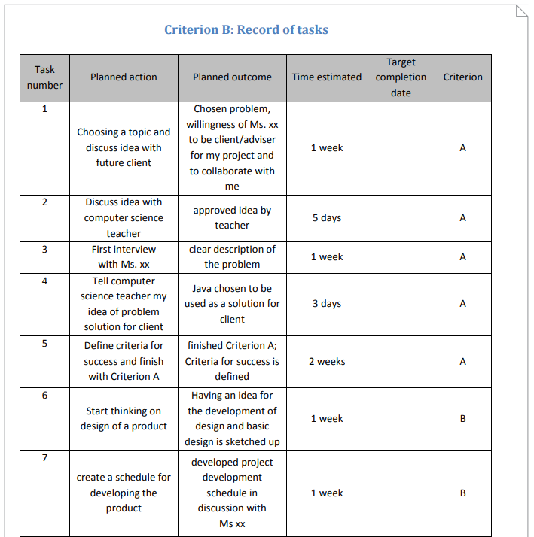
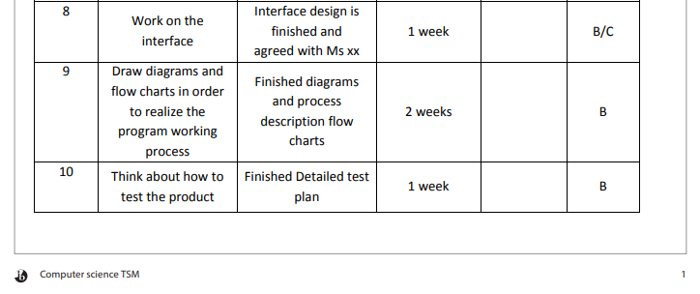
PART ONE: THE RECORD OF TASKS

Slide 5
PART TWO: DESIGN OVERVIEW
Diagrams including
Scanned sketches
Lists/Concise statements (NO extended writing)
Table for assets and techniques used
Testing plan laid out
Different levels of draft design:
Structure/internal layout
Classes, sub-classes, tables, queries, style sheets, graphic elements, effects

Slide 6
SUCCESS CRITERIA
BULLET POINT LIST
The final component of Criteria A is to list the success criteria
What things does your solution need to have to truly solve the problem
Success criteria should mostly be given by the client
These should be specific and testable

Slide 7
NOTES
THE TEMPLATE FOR THIS SECTION IS OPTIONAL
*BUT I RECOMMEND IT
Evidence of consolation with your advisor or client should be included in the appendix
You’ll need to refer to this in part A for maximum marks

